Slide 1
Applied Data Science L3. Data Science toolkit. Part 1
Irina Mohorianu
Head of Bioinformatics/ Scientific Computing @CSCI

Slide 2
Quick overview of your first steps in Python
This is intended as a quick recap for info already presented in other modules.
We are making sure we are all on the same page.
Basic types
Control Flow
Conditional statements
Iterating through elements
Variables and Functions
Inputs and outputs
Data visualisation
Suggested resources:
http://scipy-lectures.org/
https://scikit-learn.org/
https://pandas.pydata.org/

Slide 3
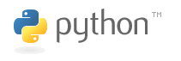
Why Python?
Python is an imperative programming language
[other examples C/ C++, Fortran, Java, Scala, C#, Perl]
[a] is interpreted (as opposed to compiled) language.
Python can be used interactively - which commands and scripts can be executed.
Python is based on OOP (object-oriented paradigm),
with dynamic typing (the same variable may refer to objects of different types during execution)
[b] is released under an open-source licence i.e. code can be used and distributed free of charge
[c] multi-platform (portable across platforms)
Python is available for all OSs, Windows, Linux/Unix, MacOS X
[d] Python is a readable language with clear non-verbose syntax
and easy to integrate/ interface with other languages, in particular C and C++.
[e] benefits from a large variety of high-quality (maintained) packages (from web frameworks to scientific computing).

Slide 4
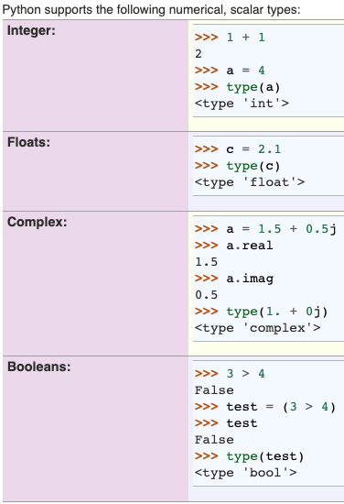
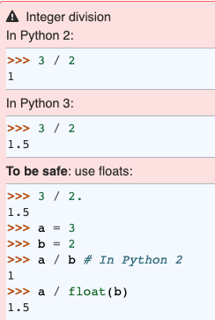
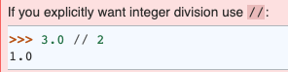
Python. Basic types
Basic arithmetic operators:
+ - * / %
Beware of differences between Python2 and Python 3

Slide 5
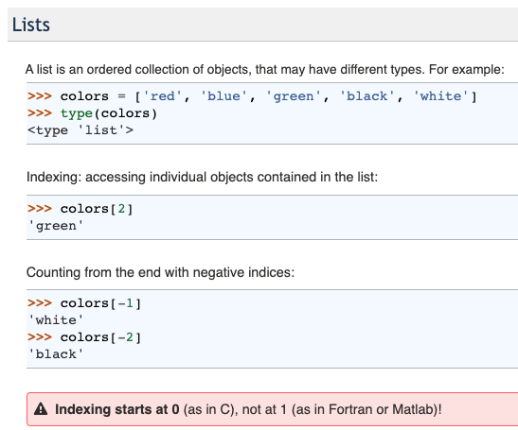
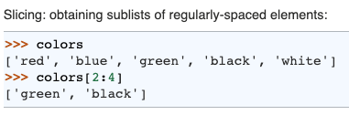
Python. Basic types. Containers

Slide 6
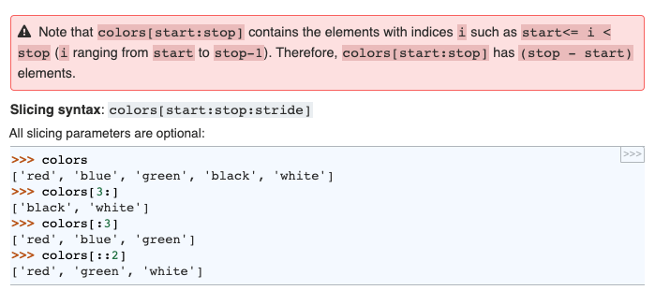
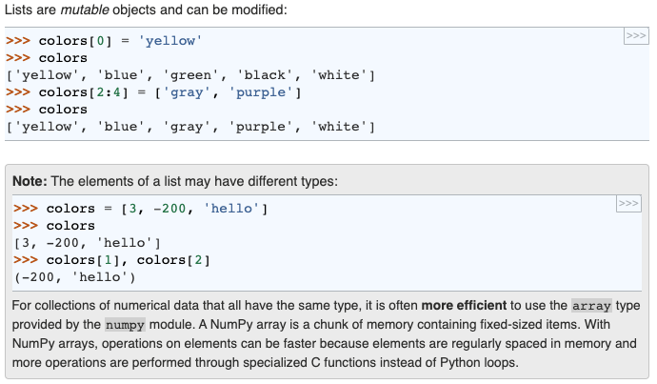
Python. Basic types. Containers

Slide 7
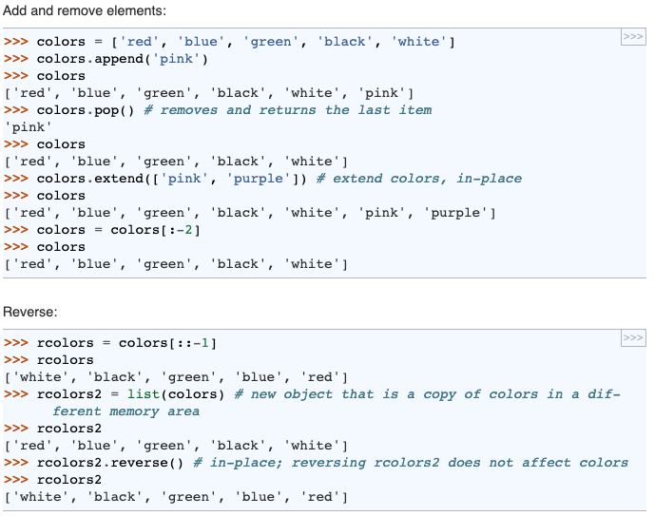
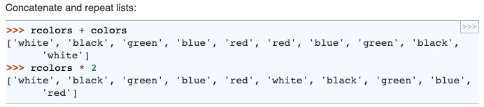
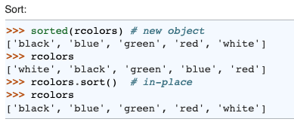
Python. Basic types. Containers

Slide 8
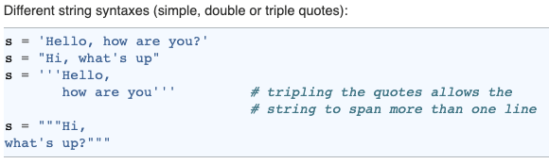
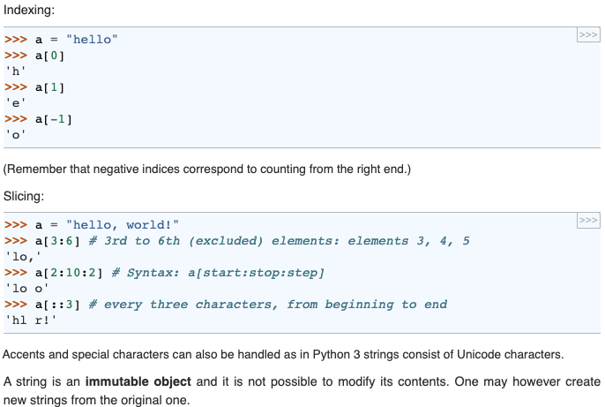
Python. Basic types. Containers

Slide 9
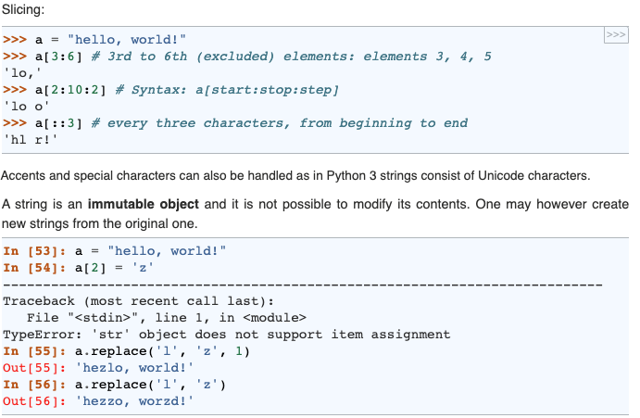
Python. Basic types. Containers

Slide 10
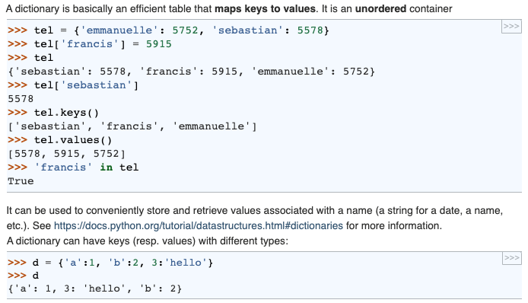
Python. Basic types. Containers

Slide 11
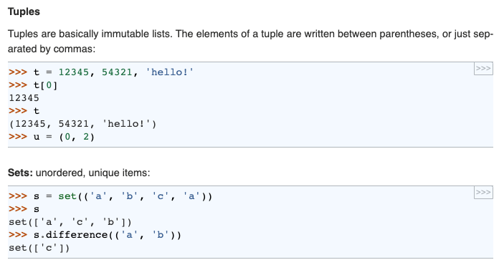
Python. Basic types. Containers

Slide 12
Python. Basic types. NumPy
NumPy (short for Numerical Python) was created in 2005 by merging Numarray into Numeric.
NumPy library has evolved into an essential library for scientific computing in Python
i.e. a building block of many other scientific libraries, such as SciPy, Scikit-learn, Pandas, and others.
What makes NumPy so very attractive to the scientific community is the convenient Python interface for working with multi-dimensional array data structures efficiently; t
The NumPy array data structure is also called ndarray, which is short for n-dimensional array.
NumPy is built around ndarrays objects - high-performance multi-dimensional array data structures.
a one-dimensional NumPy array is a data structure representing a vector of elements
i.e. a fixed-size Python list where all elements share the same type.
A two-dimensional array as a data structure to represent a matrix or a Python list of lists.
NumPy arrays can have up to 32 dimensions if it was compiled without alterations to the source code

Slide 13
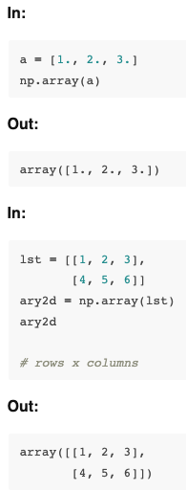
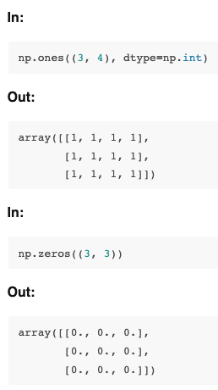
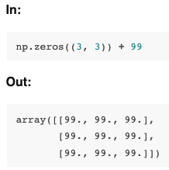
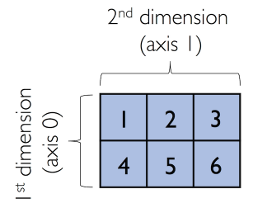
Python. Basic types. NumPy

Slide 14
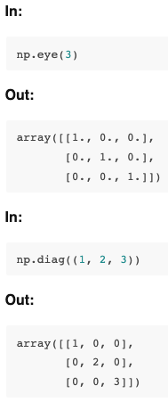
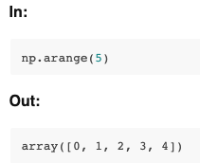
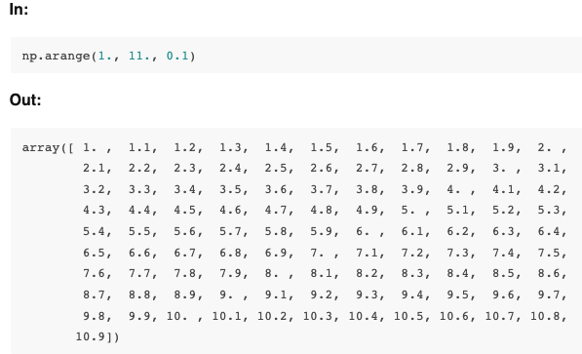
Python. Basic types. NumPy

Slide 15
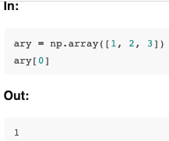
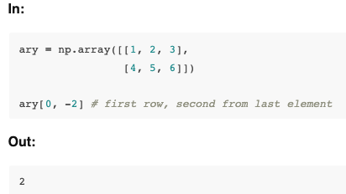
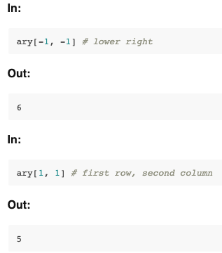
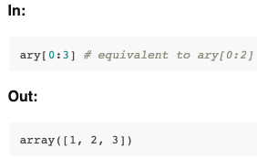
Python. Basic types. NumPy Access elements

Slide 16
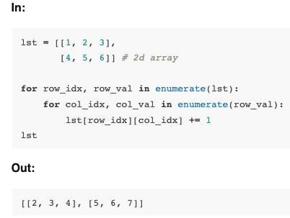
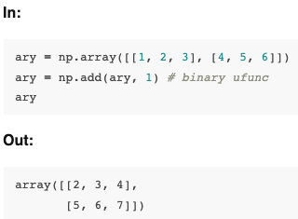
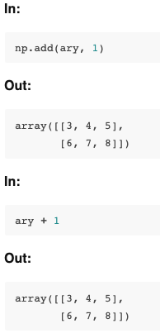
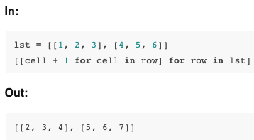
Python. Basic types. NumPy Keep it simple.
The ufuncs for basic arithmetic operations are add, subtract, divide, multiply, power, and exp (exponential). However, NumPy uses operator overloading so that we can use mathematical operators (+, -, /, *, and **) directly

Slide 17
Python. Basic types. NumPy
Other useful unary ufuncs are:
np.mean (computes arithmetic mean or average)
np.std (computes the standard deviation)
np.var (computes variance)
np.sort (sorts an array)
np.argsort (returns indices that would sort an array)
np.min (returns the minimum value of an array)
np.max (returns the maximum value of an array)
np.argmin (returns the index of the minimum value)
np.argmax (returns the index of the maximum value)
np.array_equal (checks if two arrays have the same shape and elements)

Slide 18
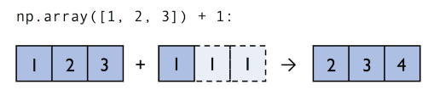
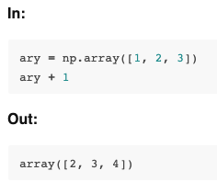
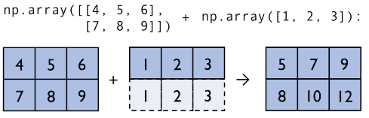
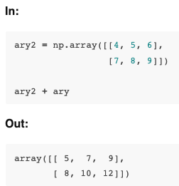
Python. Basic types. NumPy broadcasting

Slide 19
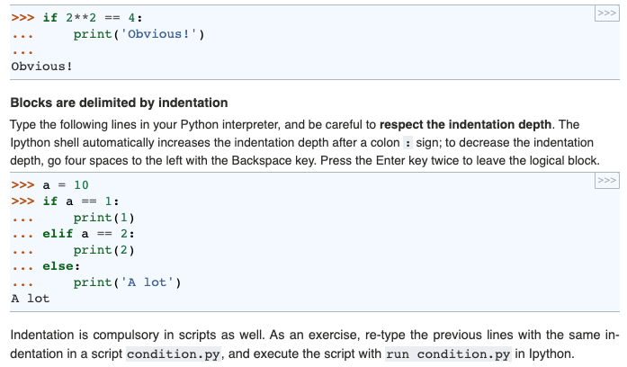
Python. Control Flow. Conditional statements

Slide 20
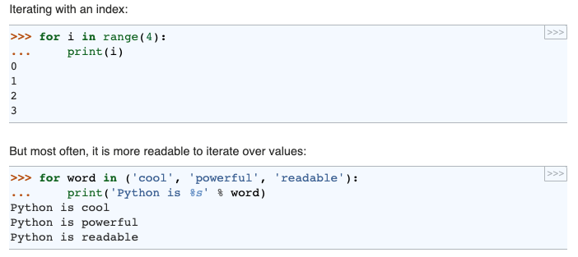
Python. Control Flow. Iterating with an index (for)

Slide 21
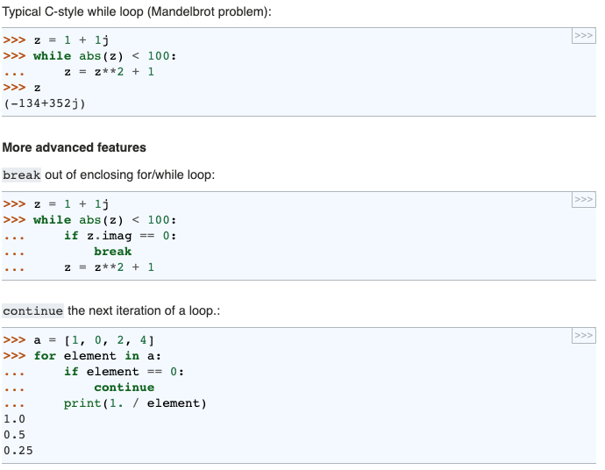
Python. Control Flow Iterating on conditions

Slide 22
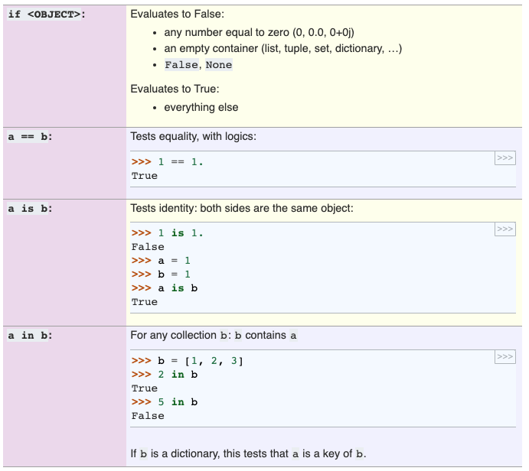
Python. Control Flow

Slide 23
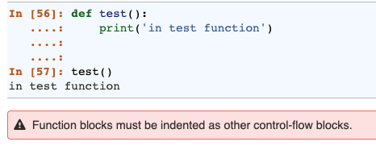
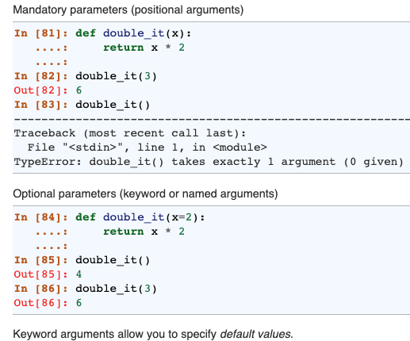
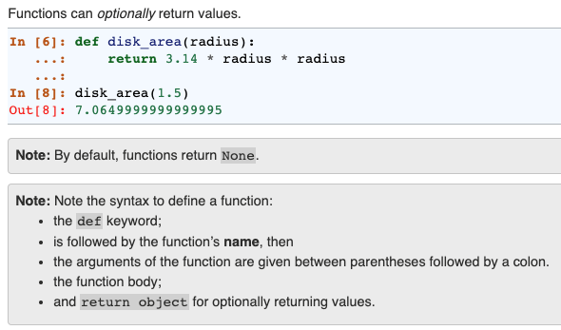
Python. Variables and functions

Slide 24
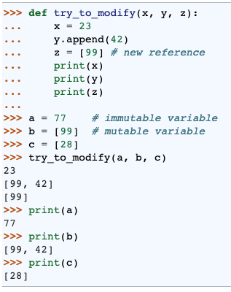
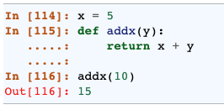
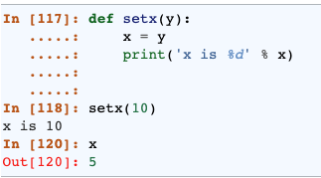
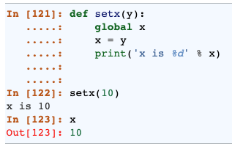
Python. Variables and functions Parameters transferred by value/ reference

Slide 25
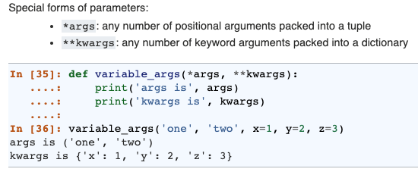
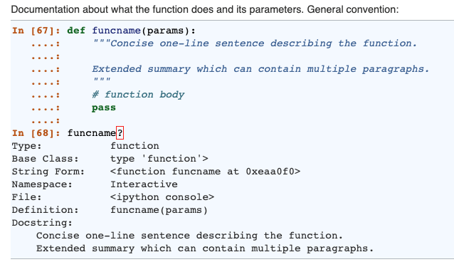
Python. Variables and functions

Slide 26
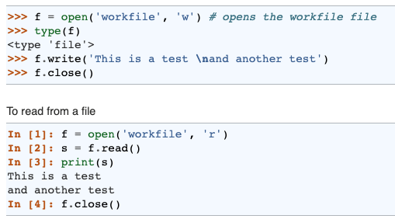
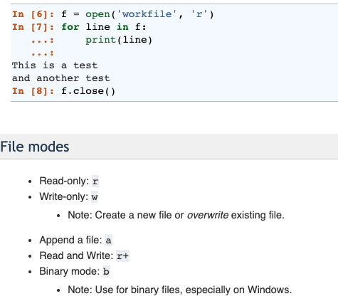
Python. Inputs and Outputs

Slide 27



Python. Exception handling easier to ask for forgiveness than permission

Slide 28

Python. Data visualisation. Matplotlib and Seaborn
Matplotlib
It is used for basic graph plotting like line charts, bar graphs and others
It mainly works with datasets and arrays.
Matplotlib acts productively with data arrays and frames. It regards the aces and figures as objects.
Matplotlib is more customizable and pairs well with Pandas and Numpy for Exploratory Data Analysis.
Seaborn
It is mainly used for statistics visualization and can perform complex visualizations with fewer commands.
It works with entire datasets.
Seaborn is considerably more organized and functional than Matplotlib and treats the entire dataset as a solitary unit.
Seaborn has more inbuilt themes and is mainly used for statistical analysis.

Slide 29


Python. Data visualisation Line plots. Matplotlib

Slide 30


Python. Data visualisation. Line plots. Matplotlib

Slide 31

Python. Data visualisation Line plots. Seaborn

Slide 32


Python. Data visualisation Bar plots

Slide 33




Python. Data visualisation Bar plots

Slide 34



Python. Data visualisation Histograms

Slide 35


Python. Data visualisation Histograms

Slide 36

Python. Data visualisation Histograms

Slide 37

Python. Data visualisation Heatmaps

Slide 38


Python. Data visualisation Heatmaps

Slide 39



Python. Data visualisation Iris datasets

Slide 40



Python. Data visualisation Iris datasets

Slide 41



Python. Data visualisation Iris datasets

Slide 42


Python. Data visualisation Iris datasets. Matplotlib

Slide 43

Python. Data visualisation Iris datasets.Matplotlib

Slide 44


Python. Data visualisation Iris dataset. Seaborn

Slide 45

Python. Data visualisation Iris dataset

Slide 46

Python. Data visualisation Iris dataset
Identify some positive/ negative characteristics for this representation

Slide 47


Python. Data visualisation Iris dataset

Slide 48

Python. Data visualisation Iris dataset
The dataset is ready for some ML pre-processing!

Slide 49

Python. SciPy. High level scientific computing
The scipy package contains various toolboxes dedicated to common issues in scientific computing. Its different submodules correspond to different applications, such as interpolation, integration, optimization, image processing, statistics, special functions, etc.
File input/output: scipy.io
Special functions: scipy.special
Linear algebra operations: scipy.linalg
Interpolation: scipy.interpolate
Optimization and fit: scipy.optimize
Statistics and random numbers: scipy.stats
Numerical integration: scipy.integrate
Image manipulation: scipy.ndimage

Slide 50



Python. SciPy. High level scientific computing scipy.io

Slide 51


Python. SciPy. High level scientific computing

Slide 52

Python.SciPy. High level scientific computing scipy.special

Slide 53

Python. SciPy. High level scientific computing scipy.linalg

Slide 54

Python. SciPy. High level scientific computing scipy.linalg

Slide 55

Python. SciPy. High level scientific computing scipy.interpolate

Slide 56


Python. SciPy. High level scientific computing scipy.optimize

Slide 57


Python. SciPy. High level scientific computing scipy. stats

Slide 58



Python.SciPy. High level scientific computing scipy.ndimage

Slide 59

Python. Scikit-learn. Machine Learning

Slide 60

Python. Scikit-learn. Machine Learning

Slide 61

Python. Scikit-learn. Machine Learning
More details on cross-validation will be provided when we discuss each approach in detail.

Slide 62
Next Lecture …
Applied Data Science L6-7. Supervised learning. Regression

